Slide 1



CS4352 Operating Systems
Lecture 14
Instructor: Yong Chen, Ph.D.
Assistant Professor
Department of Computer Science
Texas Tech University
Tommy Dang made minor modifications on the slides

Slide 2
I/O Devices (2)
I/O devices cover a huge range in speeds and needs software to perform well over orders of magnitude in data rates
Figure 5-1. Some typical device, network, and bus data rates.

Slide 3
Device Controllers
I/O devices typically consist of a mechanical component and an electronic component
Mechanical component: The device itself
Electronic component: Device controller (or adapter)
Often follows a standard interface
E.g. ANSCI, IEEE, ISO, USB, FireWire (IEEE 1394)
Has registers (for commands) and data buffer to communicate with CPU, e.g. video RAM

Slide 4
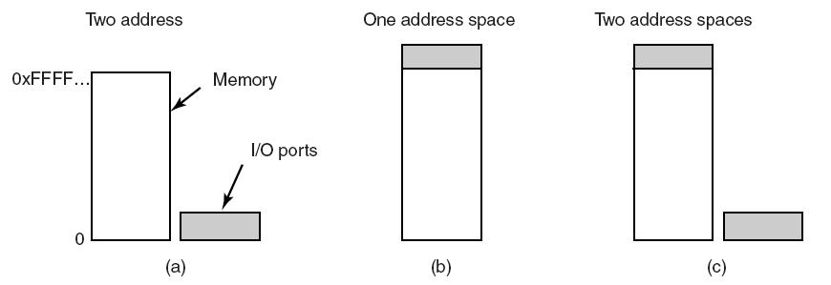
Direct I/O
Two alternatives exist for how CPU communicates with the control registers and the device data buffers
Direct I/O (separate I/O and memory space, I/O-mapped I/O)
Each control register assigned an I/O port number (forms an I/O port space)
Use explicit I/O instruction to access I/O
E.g. IN REG, PORT; OUT PORT, REG
Completely different address spaces
for memory and I/O
Figure 5-2. (a) Separate I/O and memory space

Slide 5
Memory-Mapped I/O (1)
Memory-mapped I/O: map all control registers into the memory space (single unified address space)
Control registers assigned unique memory addresses (at top)
Usually a second signal line used to tell whether I/O space or memory space needed, then memory or I/O responds
Hybrid scheme also exists
Figure 5-2. (b) Memory-mapped I/O. (c) Hybrid.

Slide 6
Memory-Mapped I/O (2)
Advantages
Device control registers can be addressed in C/C++ (like other variables) thus programs can be written entirely in C/C++
No special protection needed, OS simply refrains from putting the portion of address space containing control registers to any virtual address space
Every instruction that can reference memory can be used to reference control registers

Slide 7
Memory-Mapped I/O (3)
Disadvantages
Caching is problematic, need to disable caching control registers, per page basic -> add complexity

Slide 8
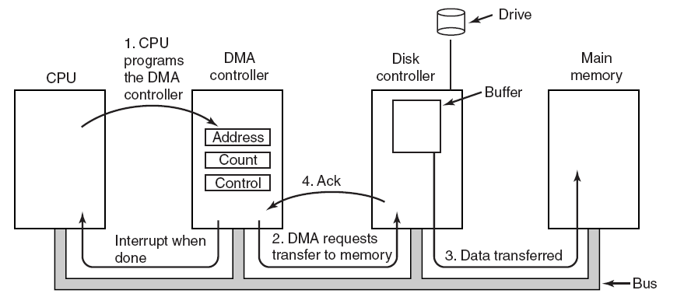
Direct Memory Access (DMA)
CPU can waste cycles if directly interacts with I/O devices
A DMA scheme is often used to free up CPU
Figure 5-4. Operation of a DMA transfer.
Notes:
Without DMA, OS use CPU to transfer byte by byte or word by word between Main memory and I/O devices.
DMA can be on each device controller or on the mother board.
DMA can handle multiple transfers at a time -> Scheduling FIFO, or round robin

Slide 9
Direct Memory Access (DMA)
DMA varies, the simple one handles one transfer at a time
Complex ones handle multiple transfers once
Device internal buffer needed even with DMA as:
Verify the checksum before a DMA transfer
Better efficiency

Slide 10
Outline
Questions?
Quiz 3 review
Principles of I/O Hardware
I/O devices and device controllers
Memory-mapped I/O and Direct Memory Access (DMA)
Principles of I/O Software
Goals of I/O software
Programmed I/O, interrupt-driven I/O and I/O using DMA

Slide 11
Goals of the I/O Software (1)
Device independence
Programs developed should be independent from devices
E.g. read a file on a hard disk drive/CD-ROM/DVD/USB drive
OS needs to take care of the difference of devices and hides them
Uniform naming
Name of a device should be a string or an integer, independent from the device
Error handling
Error handling should be as close to the hardware as possible
E.g. controller -> device driver -> upper layers

Slide 12
Goals of the I/O Software (2)
Synchronous v.s. Asynchronous
Synchronous: blocking (lower performance), easier to develop programs
Asynchronous: interrupt-driven, non-blocking, harder to develop
Buffering (often needed)
Sharable v.s. dedicated devices
Some devices can be shared by multiple users simultaneously, e.g. disks, whereas some others are not, e.g. printers

Slide 13
Readings
Chapter 5:
Section 5.1
Section 5.2

Slide 14
I/O Software Layers

Slide 15
Device Drivers (1)
Device driver: a device-specific code that controls devices
Normally provided by devices’ manufacturer
Usually handles one device type or one class of related devices
Normally part of OS kernel
Normally needs OS to have a well-defined model for what an outsider driver does and how interacts with the rest OS

Slide 16
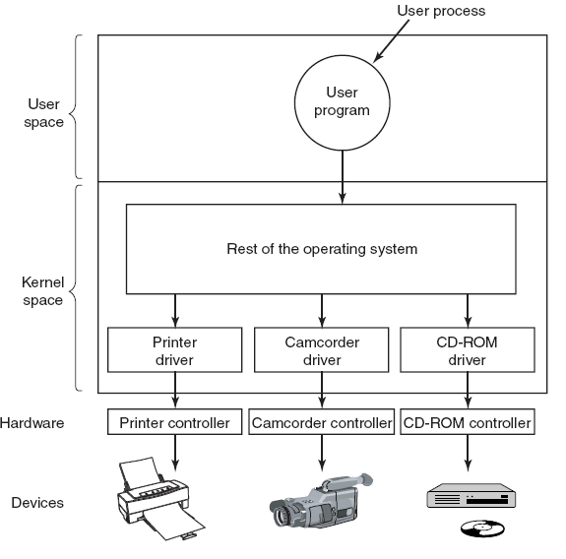
Device Drivers (2)
Figure 5-12. Logical positioning of device drivers. In reality all communication between drivers and device controllers goes over the bus.

Slide 17
Device Drivers (3)
Functionalities
Accept abstract read/write requests from the device-independent software above it
Manage devices, initialize devices, manage power and logs

Slide 18
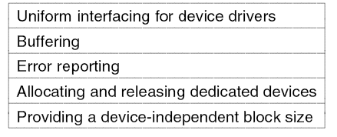
Device-Independent I/O Software
To perform the I/O functions that are common to all devices and to provide a uniform interface to the user-level software
Figure 5-13. Functions of the device-independent I/O software.

Slide 19
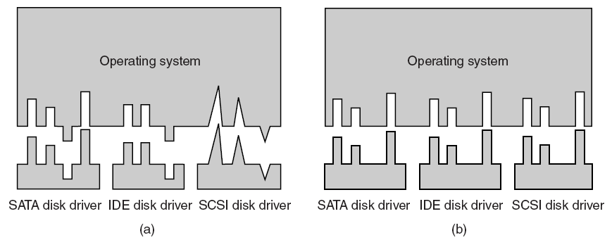
Uniform Interfacing for Device Drivers
Same driver interface desired
OS defines a set of functions that drivers must supply
OS sets unified device names as well, e.g. with major device number and minor device number
Figure 5-14. (a) Without a standard driver interface. (b) With a standard driver interface.

Slide 20
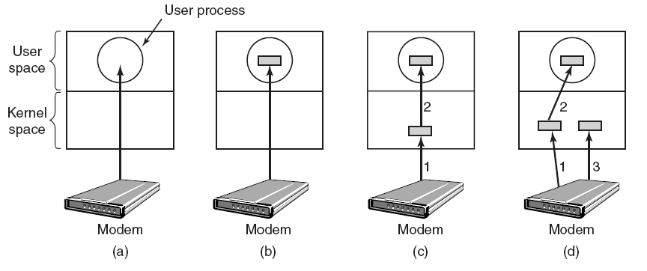
Buffering
Buffering often needed for both block and character devices
Double buffering widely used
Figure 5-15. (a) Unbuffered input. (b) Buffering in user space. (c) Buffering in the kernel followed by copying to user space.
(d) Double buffering in the kernel.

Slide 21
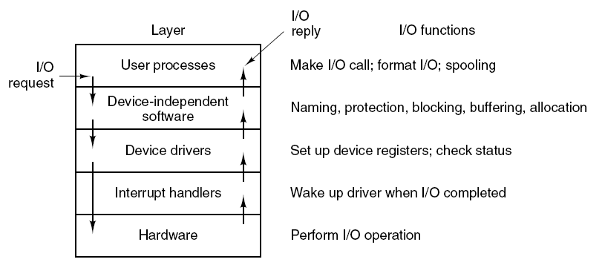
Summary of I/O Software Layers
Figure 5-17. Layers of the I/O system and the main functions of each layer.

Slide 22
Outline
Questions?
Principles of I/O Software
Programmed I/O, interrupt-driven I/O and I/O using DMA
I/O Software Layers
Interrupt handlers, device drivers
Device-independent I/O software, user-space I/O software
Disks
Magnetic disks

Slide 23
Disks
Storage hardware: a variety of types
Magnetic disks: hard disks and floppy disks
RAID: Redundant Array of Inexpensive/Independent Disks
Solid State Drives (SSDs)
CD-ROMs
CD-Recordables
DVDs

Slide 24
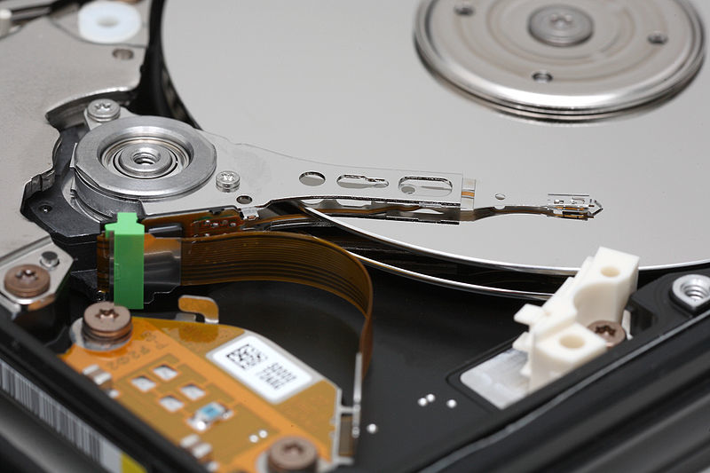
Magnetic Disks

Slide 25
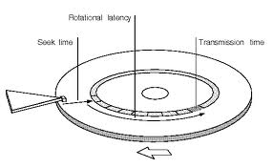
Disk Drive Performance
Write/Read Requests arrive at the disk as block (sector) requests
Seek Time: Disk head must move to the correct track
Latency: Time for the rotation of the disk to reach the correct sector
Best Case: 0
Worst Case: Full Rotation (15K RPM = 250 RPS = 4 millisecs)
Access Time
Seek Time + Latency + Transfer Time

Slide 26
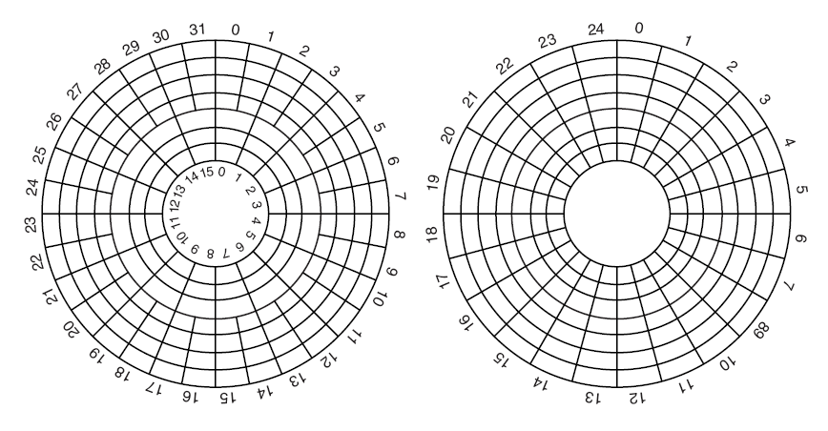
Physical geometry v.s. virtual geometry
Figure 5-19. (a) Physical geometry of a disk with two zones. (b) A possible virtual geometry for this disk.

Slide 27
Disk Arm Scheduling Algorithms (1)
Read/write time factors
Seek time (the time to move the arm/head to the proper cylinder).
Latency/rotational time (the time for the proper sector to rotate under the head).
Actual data transfer time.

Slide 28
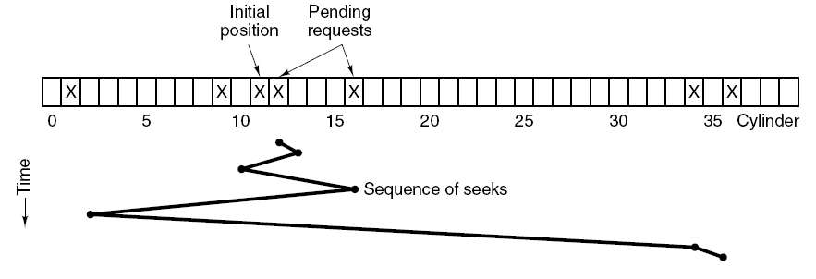
Disk Arm Scheduling Algorithms (2)
FCFS performs poorly and has low efficiency even fair
E.g. requests: cylinder 11, 1, 36, 16, 34, 9, 12
Shortest Seek First (SSF) optimizes seek time but loses fairness
Figure 5-24. Shortest Seek First (SSF) disk scheduling algorithm.

Slide 29
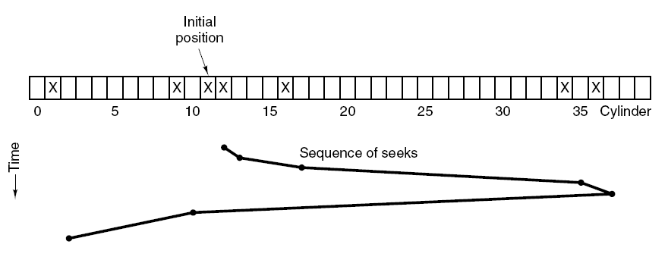
Disk Arm Scheduling Algorithms (3)
Elevator algorithm
Moving UP
Moving DOWN
Figure 5-25. The elevator algorithm for scheduling disk requests.

Slide 30
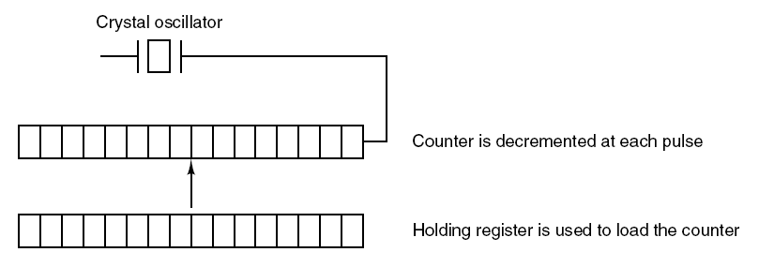
Clocks and Clock Hardware (1)
Clocks (timers) maintain time and generate interrupts
Old clocks use voltage cycle to generate interrupt at 50/60Hz
Common clocks nowadays use crystal oscillator (up to 1000MHz)
Interrupt intervals can be programmed with the register, “clock ticks”
Figure 5-28. A programmable clock.

Slide 31
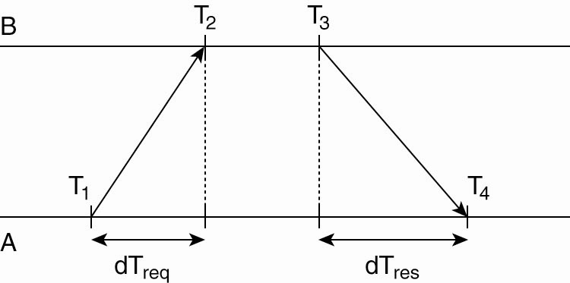
Clock Synchronization: Network Time Protocol (NTP)
Synchronize with a time server
Time server: equipped with a WWV/satellite receiver
Messages have delays and can have outdated reported time
Need to estimate delays
Offset estimated as:
Getting the current time from a time server.

Slide 32
Outline
Questions?
Clocks
Clock hardware, synchronization
Clock software, soft timers
User interface devices
Input devices
Output devices
Power management
Hardware/software

Slide 33
Graphical User Interfaces (1)
A GUI has four essential elements, denoted as WIMP
Windows
Icons
Menus
Pointing device
Output almost always needs a special hardware, graphics adapter (GPU) with video RAM

Slide 34
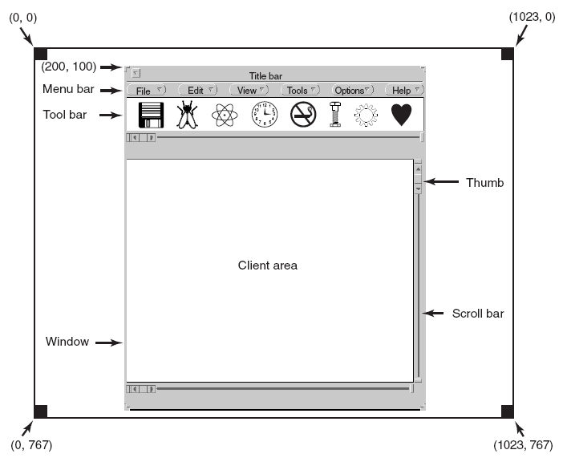
Graphical User Interfaces (2)
Figure 5-35. A sample window located at (200, 100) on an XGA display.

Slide 35
Outline
Questions?
Clocks
Clock hardware, synchronization
Clock software, soft timers
User interface devices
Input devices
Output devices
Power management
Hardware/software

Slide 36
Power Management
Power has become a practical & critical limitation for computing
Power consumption limits the frequency of single-core CPU and changes to multicore/manycore architecture
Energy bill (power, cooling) of supercomputers can be even more expensive than supercomputers themselves

Slide 37
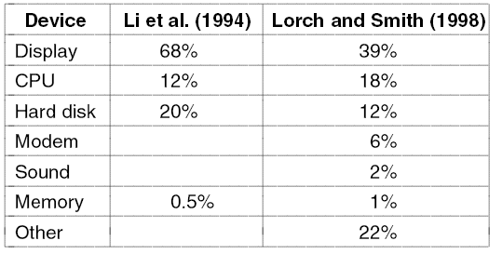
Power Management Hardware Issues
Figure 5-40. Power consumption of various parts of a notebook computer.

Slide 38
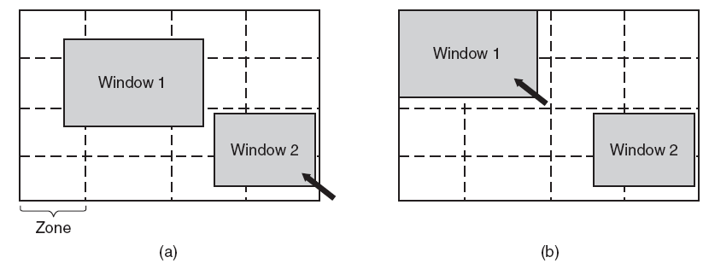
Power Management The Display
Figure 5-41. The use of zones for backlighting the display. (a) When window 2 is selected it is not moved. (b) When window 1 is selected, it moves to reduce the number of zones illuminated.

Slide 39
Readings
Chapter 5:

